Slide 1
Task 2 – Seminar 2
The Time Dynamics of Fasted vs. Fed Gastric Emptying in Rat

Slide 2
Q1. Model fasted gastric emptying (GE_fasted) to determine the rate and half-life of gastric emptying.
Visualisation
Fit appropriate model
Analyse output
Predict data with model
Determine parameters
Alternative approach?
Comparing models

Slide 3
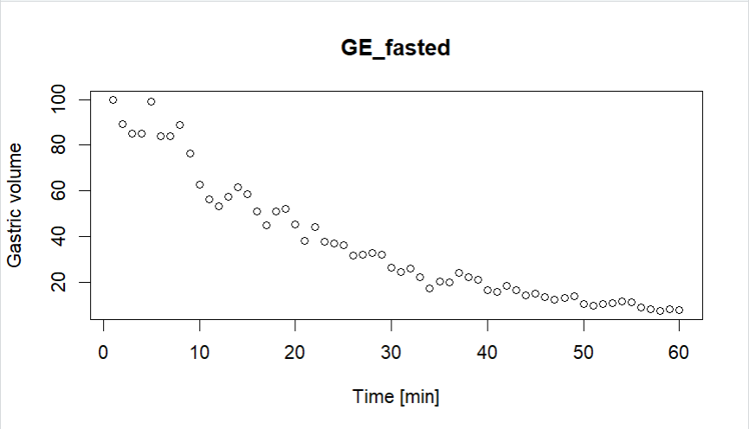
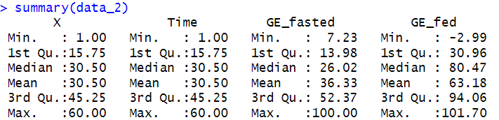
Visualisation

Slide 4
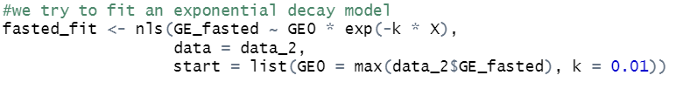
Fit appropriate model
We assume the data to follow an exponetnial trend

Slide 5
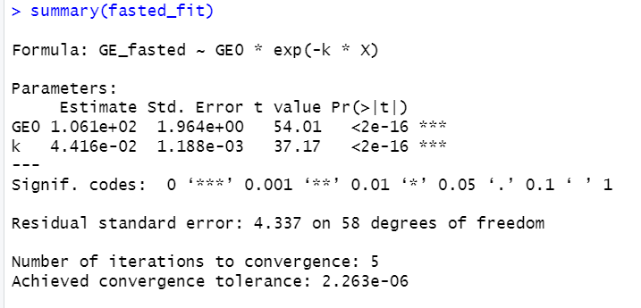
Analyse output
The model summary shows:
Low standard errors
High t-values
Statistically significant p-values
Low residuals

Slide 6
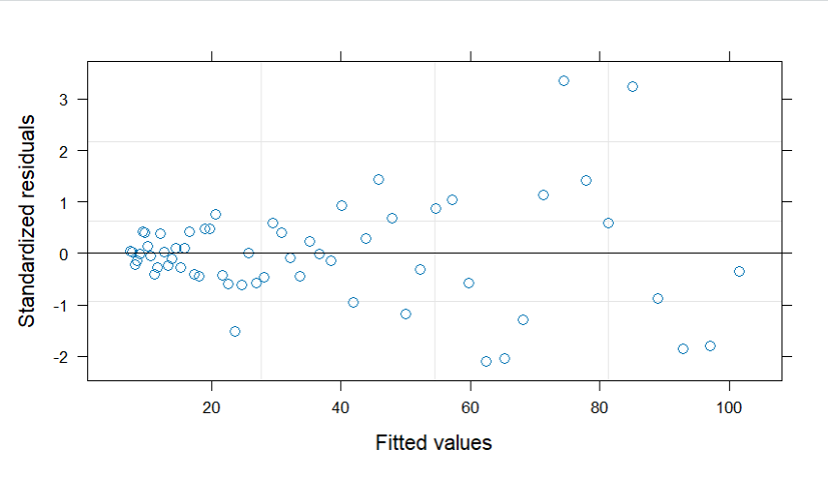
Analyse output

Slide 7
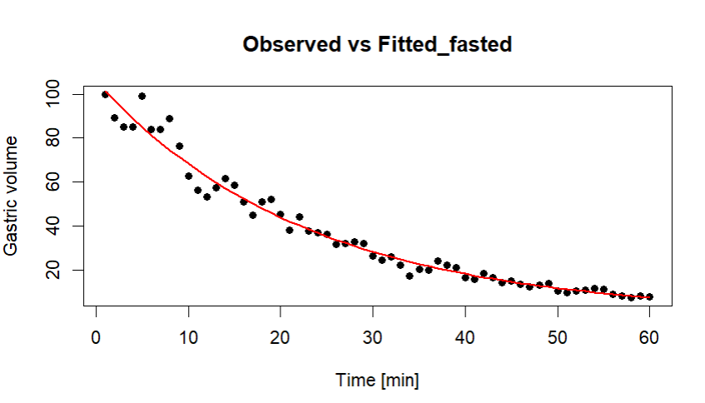
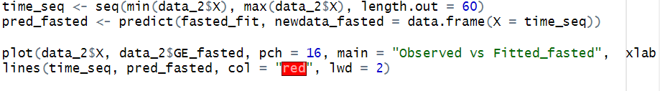
Predict data with model

Slide 8
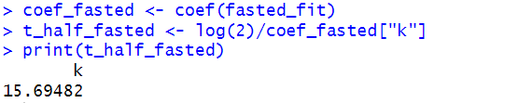
Determine parameters
From this model we determine:
Rate constant (k): 0.0044
Half-life (t₁/₂): 15.7

Slide 9
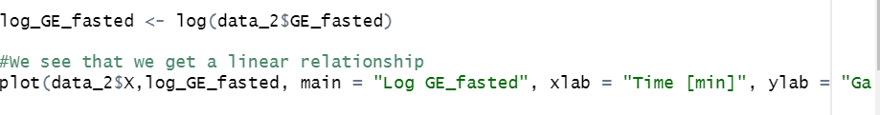
Alternative approach?
Log-transforming the data

Slide 10
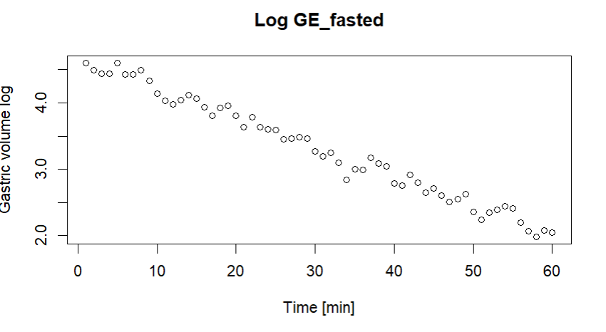
Alternative approach?
Visualisation -> linear

Slide 11
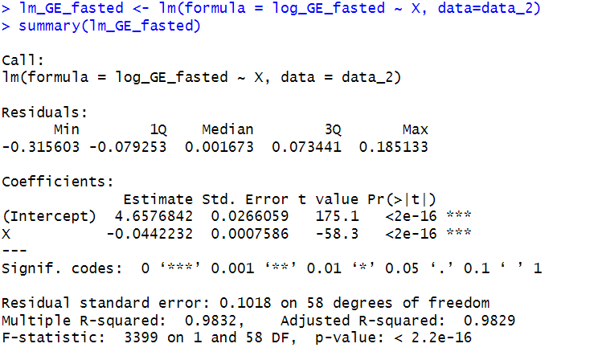
Alternative approach?
Fit a linear model ->
The residuals are normally distributed
Standard errors are low
R² value is close to 1.

Slide 12

Comparing models
Akaike Information Criterion (AIC)

Slide 13
Q2. Model the fed state gastric emptying profile.
Preprocessing of data
Visualisation of data
Fit appropriate model
Analyse output
Predict data with model

Slide 14
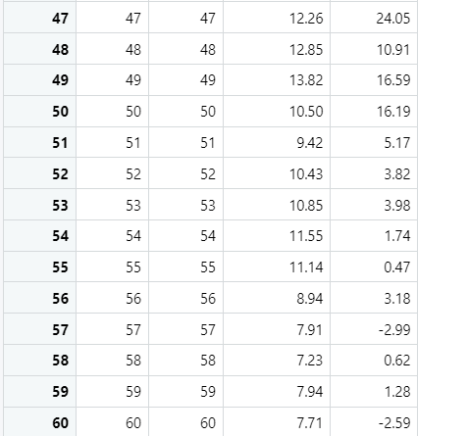

Preprocessing of data
Remove data that is not physically possible

Slide 15
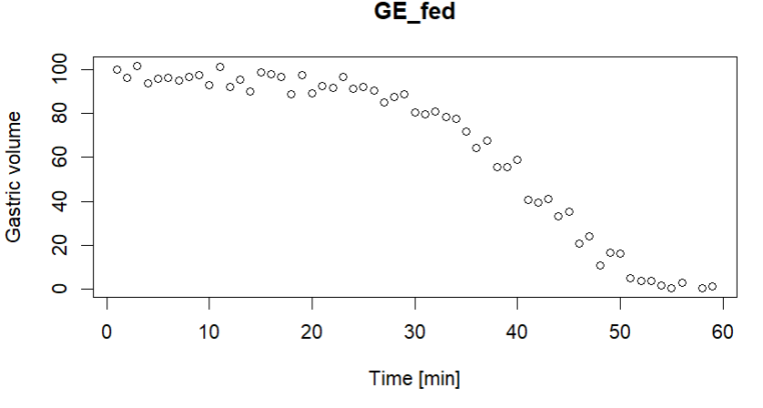
Visualisation of data

Slide 16
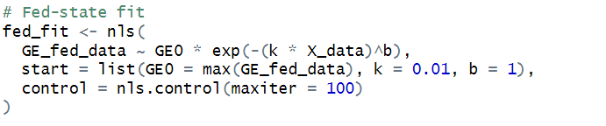
Fit appropriate model
We fit a Weibull model, which incorporates a lag parameter.

Slide 17
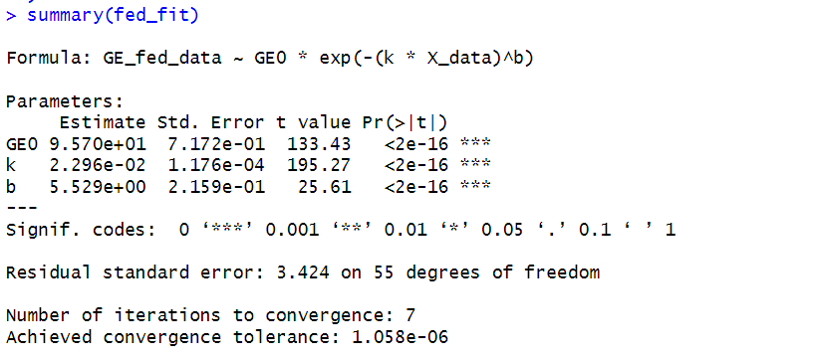
Analyse output
The Weibull model shows:
Low standard errors
Statistically significant p-values
Low residuals

Slide 18
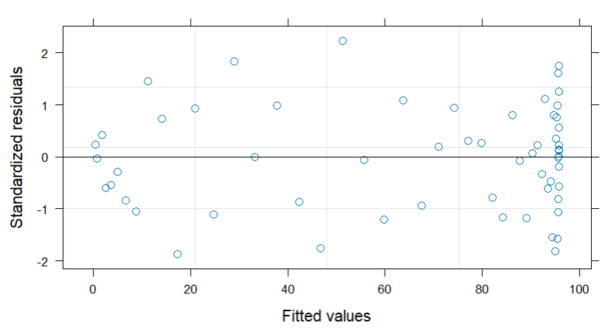
Analyse output

Slide 19
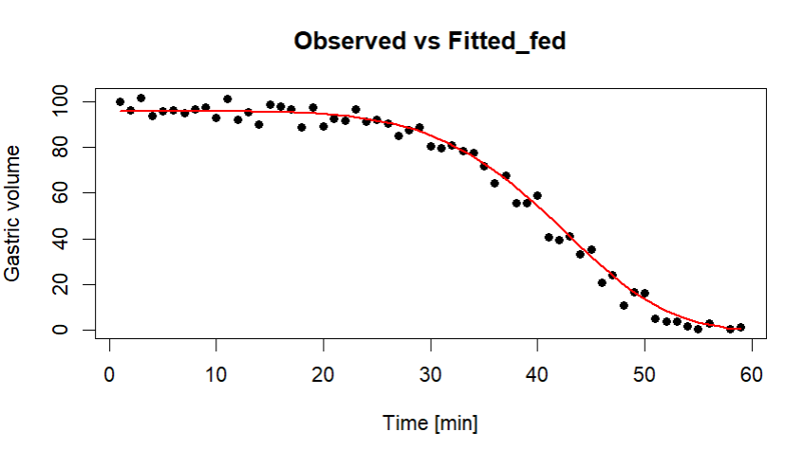
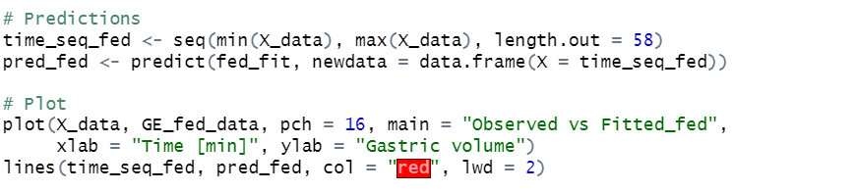
Predict data with model

Slide 20

Q3. In larger studies we normally depend on secondary parameters (such as half-life) rather than the time-dynamic profiles. For the fed state gastric emptying profile, how informative is half-life for describing the time-dynamics? Can you propose alternative secondary parameters?

Slide 21
half-life is not always informative for the fed state
Different curve shapes can yield the same t₅₀.
Subjects may share identical t₅₀ values but differ in early retention, which has important clinical implications.
Half-life assumes exponential decay and does not account for the lag phase.

Slide 22
Comparing half life
T₁/₂ (fasted): 15.7
T₁/₂ (fed): 30.2

Slide 23
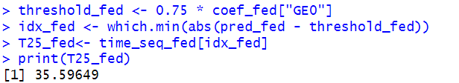
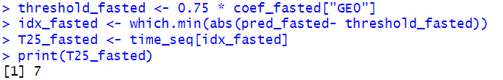
Example of another parameter
T-lag25- time until 25% of gastric volume is emptied

Slide 24
Other paramter examples
Time at Steepest decline (most negative derivate)
Area under the curve (AUC)

Slide 25
Conclusion
Fasted gastric emptying is well described by an exponential (or log-linear) model with a half-life of ~15.7 minutes.
Fed gastric emptying requires a Weibull model due to the initial lag phase; half-life (~30.2 minutes) is insufficient to describe its dynamics.
Half-life is not always informative in the fed state. Alternative secondary parameters such as T-lag25 and time at steepest decline, AUC provide a more accurate representation of gastric emptying dynamics.

